Slide 1
Project- Insurance claim
Submitted by : Riya Raj (imriya3099@gmail.com)

Slide 2
Introduction of this project
An insurance company in US is reviewing its insurance claim/charges and tyring to do a cause and effect analysis for future business decisions. It has collected data for its customers’ age, gender, bmi, number of children/dependants, smoking habit, region they belong to, charges/bills claimed under the insurance.

Slide 3
Exploratory Data Analysis on the sample data
Q.1: Interpretation of a, b
- More young people (18–30 age group) in the examined demographic.
- Higher number of people with lower insurance costs; a smaller number with higher insurance costs.
- Interest in identifying individuals with higher insurance costs.
- Graphs indicate that middle-aged and possibly older individuals may have higher insurance bills.
- Inquiry into whether age is the sole factor or if other elements contribute to insurance costs.
- Regular distribution observed in BMI.
- Anomalies noted in charges and BMI; suggesting potential areas for independent investigation.
- Possibility of exploring if higher BMI is linked to increased health issues and claims.
Q.1 -b Correlation chart interpretation
We don't see any major correlation, but Age and charges show some bit of positive relation with each other.

Slide 4
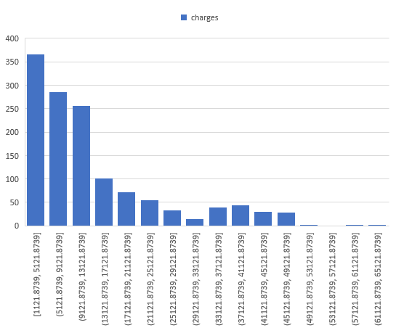
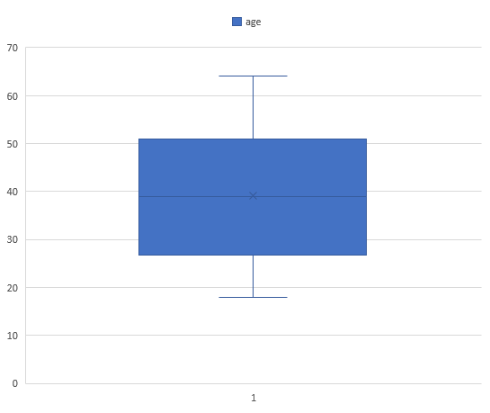
Categorical data: Sex, Chidren, Smoker, Region Continuous data: Age, bmi, charges

Slide 5
Male/Female ratio and which gender has more smokers
Males smokers more than by female smokers

Slide 6
Charges for Smokers vs Non-smokers
Smokers get billed much more as compared to non-smokers

Slide 7
Edit the data as following, to obtain dummy variables
Region: We always create one less category column for the dummy data w.r.t the categories available for that original variable. So for Region, we will create three dummy columns, assuming “Northeast” as zero and omit the column for it. Now create three columns for “northwest”, “Southeast”, “Southwest”. Whichever row has “northwest” region as an entry will take “1” as an entry otherwise “0” in “northwest” column. Similarily in “Southeast” column, which ever row had “southeast” as an entry will take “1” as the new entry and “0” for the rest columns. Do a similar operation on “Southwest” column.
Regression Statistics
Multiple R | 0.870189
R Square | 0.757228
Adjusted R Square | 0.755767
Standard Error | 5984.76
Observations | 1338
 | Coefficients | Standard Error | t Stat | P-value | Lower 95% | Upper 95% | Lower 95.0% | Upper 95.0%
Intercept | -11634.1 | 942.3659 | -12.3456 | 3.16E-33 | -13482.8 | -9785.39 | -13482.8 | -9785.39
age | 256.588 | 11.76251 | 21.81405 | 2.02E-90 | 233.5129 | 279.6631 | 233.5129 | 279.6631
bmi | 337.0905 | 28.21752 | 11.94614 | 2.56E-31 | 281.7348 | 392.4463 | 281.7348 | 392.4463
children | 484.9406 | 136.0019 | 3.565689 | 0.000376 | 218.1387 | 751.7424 | 218.1387 | 751.7424
smoker | 21329.25 | 595.9616 | 35.78964 | 5.4E-197 | 20160.12 | 22498.38 | 20160.12 | 22498.38
southeast | -2047.03 | 462.2774 | -4.42814 | 1.03E-05 | -2953.9 | -1140.16 | -2953.9 | -1140.16
southwest | -1487.86 | 451.3971 | -3.29611 | 0.001006 | -2373.38 | -602.327 | -2373.38 | -602.327
southeast_smoker | 5359.478 | 938.313 | 5.711823 | 1.38E-08 | 3518.741 | 7200.214 | 3518.741 | 7200.214
southwest_smoker | 3761.211 | 1053.19 | 3.571256 | 0.000368 | 1695.115 | 5827.307 | 1695.115 | 5827.307

Slide 8
Descriptive summary analysis for the edited data
 | Coefficients | Standard Error | t Stat | P-value | Lower 95% | Upper 95% | Lower 95.0% | Upper 95.0%
Intercept | -11634.1 | 942.3659 | -12.3456 | 3.16E-33 | -13482.8 | -9785.39 | -13482.8 | -9785.39
age | 256.588 | 11.76251 | 21.81405 | 2.02E-90 | 233.5129 | 279.6631 | 233.5129 | 279.6631
bmi | 337.0905 | 28.21752 | 11.94614 | 2.56E-31 | 281.7348 | 392.4463 | 281.7348 | 392.4463
children | 484.9406 | 136.0019 | 3.565689 | 0.000376 | 218.1387 | 751.7424 | 218.1387 | 751.7424
smoker | 21329.25 | 595.9616 | 35.78964 | 5.4E-197 | 20160.12 | 22498.38 | 20160.12 | 22498.38
southeast | -2047.03 | 462.2774 | -4.42814 | 1.03E-05 | -2953.9 | -1140.16 | -2953.9 | -1140.16
southwest | -1487.86 | 451.3971 | -3.29611 | 0.001006 | -2373.38 | -602.327 | -2373.38 | -602.327
southeast_smoker | 5359.478 | 938.313 | 5.711823 | 1.38E-08 | 3518.741 | 7200.214 | 3518.741 | 7200.214
southwest_smoker | 3761.211 | 1053.19 | 3.571256 | 0.000368 | 1695.115 | 5827.307 | 1695.115 | 5827.307
Regression Statistics
Multiple R | 0.870189
R Square | 0.757228
Adjusted R Square | 0.755767
Standard Error | 5984.76
Observations | 1338

Slide 9
Interpretation for the above anslysis
Upon examining the normality plot, it is evident that the data is not perfectly normally distributed, given the presence of numerous outliers, which could be considered natural outliers.
The R-square values obtained are deemed satisfactory for a real-life case study.
When interpreting observations related to regions, the focus should be on the "northeast" region.
Contrary to expectations derived from the Exploratory Data Analysis (EDA), the analysis reveals a reduction in charges for the southeast region compared to the northeast region.
Considering these findings, it is advisable to conduct another regression analysis, this time excluding the variables "northwest" and "sex."
In terms of their t-stat values, the variables "smoker," "age," "bmi," and the number of children are identified as important, with "smoker" being the most influential.
The southeast region exhibits a negative relationship with charges concerning the northeast, indicating that individuals from the southeast region tend to make fewer insurance claims than those from other regions.
Contrarily, the southwest region does not emerge as a significant variable in the analysis.
Examination of standardized residuals reveals no discernible pattern, indicating the absence of heteroscedasticity.
It is advisable to explore the combined effect of region and smoking habit. Consequently, the data is being further refined to account for this aspect.

Slide 10


